Slide 1
Artificial Intelligence
Decision Trees
Notes:
Slides and exercises are inspired by Russell & Norvig AI Book, Stanford’s AI course and from Berkeley’s AI course

Slide 2
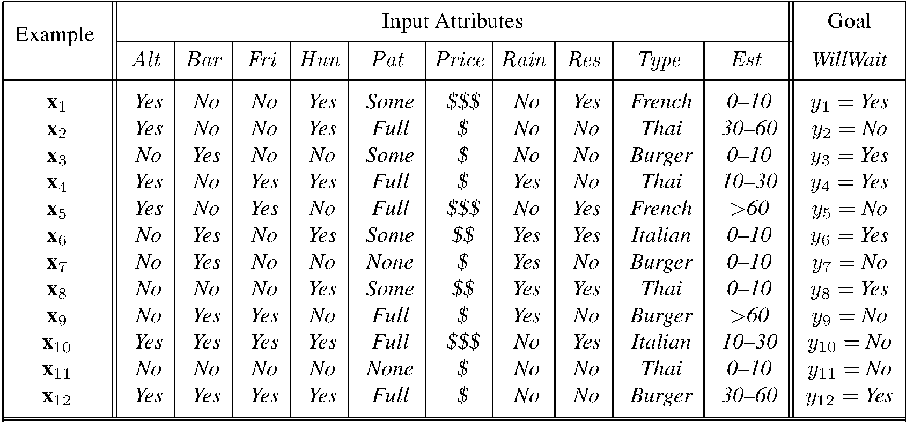
Training data
1. Alternate: whether there is a suitable alternative restaurant nearby.
2. Bar : whether the restaurant has a comfortable bar area to wait in.
3. Fri/Sat: true on Fridays and Saturdays.
4. Hungry: whether we are hungry.
5. Patrons: how many people are in the restaurant (values are None, Some, and Full ).
6. Price: the restaurant’s price range ($, $$, $$$).
7. Raining: whether it is raining outside.
8. Reservation: whether we made a reservation.
9. Type: the kind of restaurant (French, Italian, Thai, or burger).
10. WaitEstimate: the wait estimated by the host (0–10 minutes, 10–30, 30–60, or >60).

Slide 3
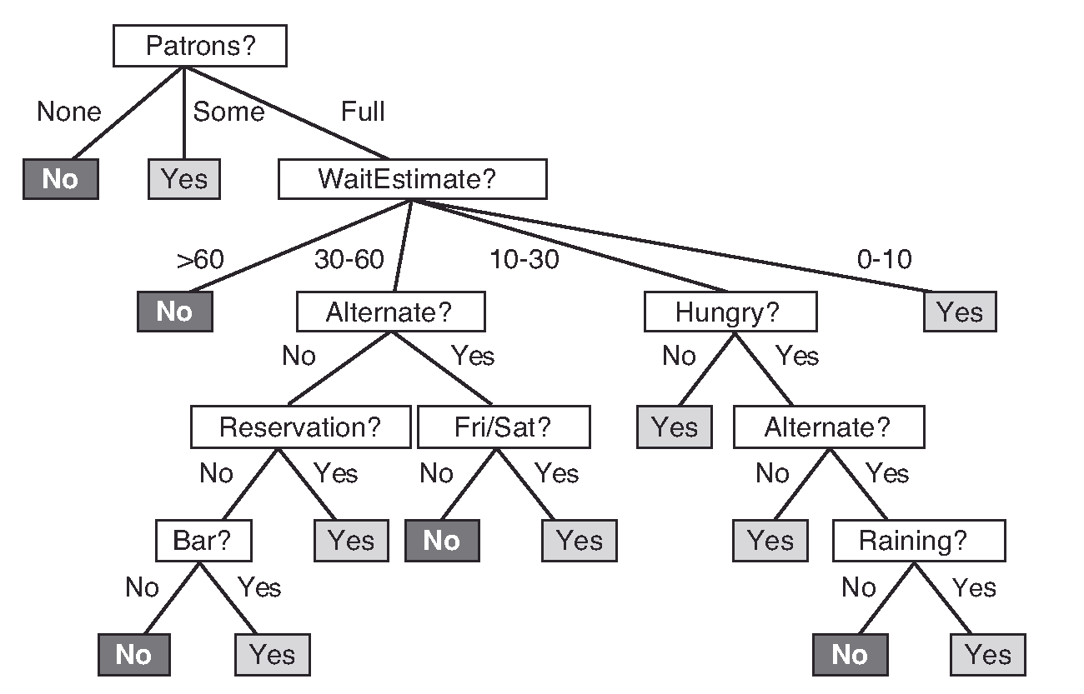
Wait at restaurant?
Decision tree induction is one of the simplest and yet most successful forms of machine learning.
We want a tree that is consistent with the training examples and is as small as possible

Slide 4
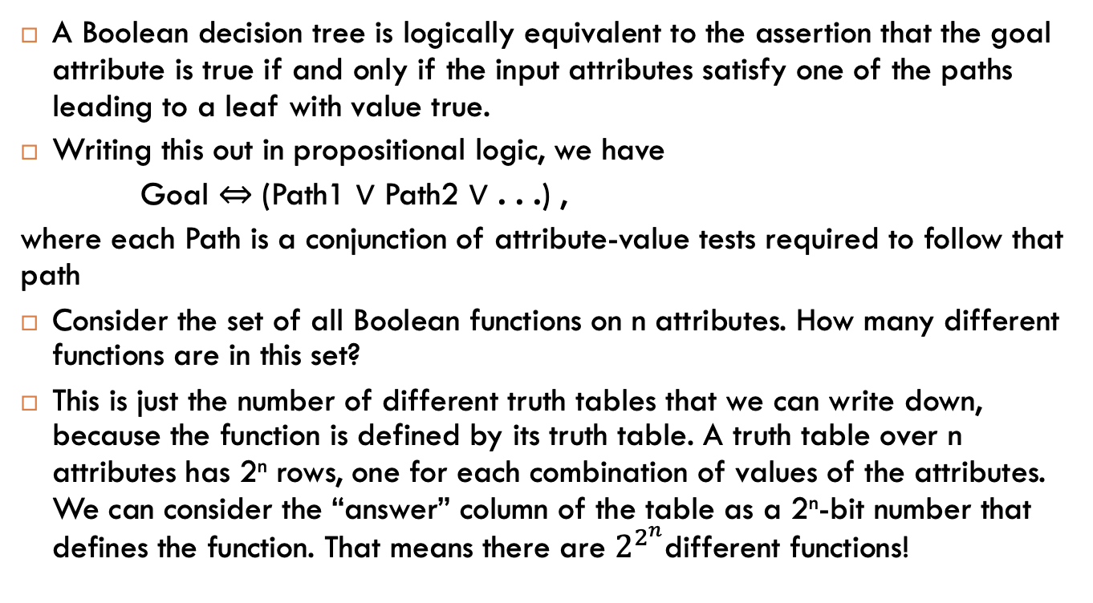
Definition
A Boolean decision tree is logically equivalent to the assertion that the goal attribute is true if and only if the input attributes satisfy one of the paths leading to a leaf with value true.
Writing this out in propositional logic, we have
Goal ⇔ (Path1 ∨ Path2 ∨ . . .) ,
where each Path is a conjunction of attribute-value tests required to follow that path
Consider the set of all Boolean functions on n attributes. How many different functions are in this set?
This is just the number of different truth tables that we can write down, because the function is defined by its truth table. A truth table over n attributes has 2^{n} rows, one for each combination of values of the attributes. We can consider the “answer” column of the table as a 2^{n}-bit number that defines the function. That means there are $2^{2^{n}}$different functions!
Notes:
E.g., with 6 Boolean attributes, there are 18,446,744,073,709,551,616 trees

Slide 5
Smaller hypothesis space
Choose a variable, split up the data according to this variable, repeat …
For a tree of depth 1 (splitting on one variable):
A truth table with 2 rows => 2² functions
For depth n, we have 4n decision stumps
If the remaining examples are all positive (or all negative), then we are done: we can answer Yes or No.
If there are some positive and some negative examples, then choose the best attribute to split them.
Two special cases:
If there are no examples left, it means that no example has been observed for this combination of attribute-values, and we return a default value calculated from the plurality of all the examples that were used in constructing the node’s parent.
If there are no attributes left, but both positive and negative examples, it means that these examples have exactly the same description, but different classifications. This can happen because there is an error or noise in the data; because the domain is nondeterministic; or because we can’t observe an attribute that would distinguish the examples. The best we can do is to return the plurality classification of the remaining examples.

Slide 6
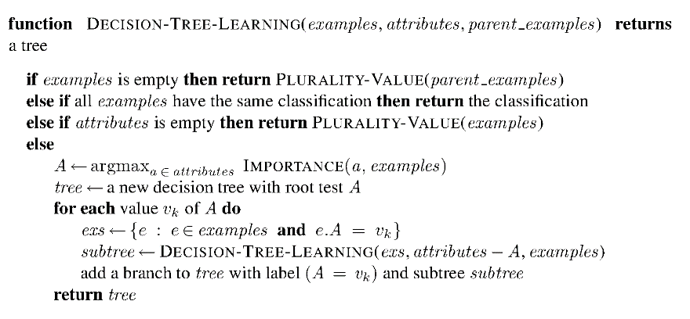
Decision tree algorithm

Slide 7
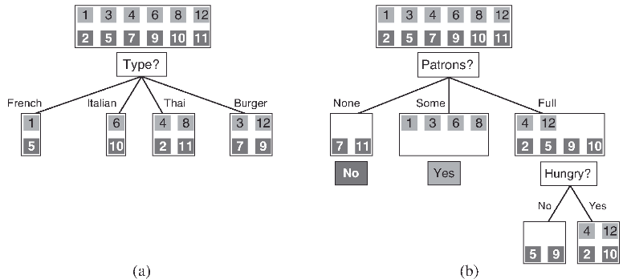
How to split data?

Slide 8
Entropy
Information questions
The more uncertain about the answer initially, the more information in the answer
Measured in bits
Answer to Boolean question with prior [½ , ½] ?
Answer to 4-way question with prior [ ¼, ¼ , ¼ , ¼]?
-1/4 * log (1/4) + -1/4 * log (1/4) + -1/4 * log (1/4) + -1/4 * log (1/4)=
4 * 1/ 4 log(4) = log (4) = 2
Answer to 4-way question with prior [ 0, 0 , 0 , 1]?
0
Answer to 3-way question with prior [ ½ , ¼, ¼ ]?
-1/2 log ½ - ¼ log ¼ -1/4 log ¼ = ½ + ½ + ½ = 1.5 bits

Slide 9
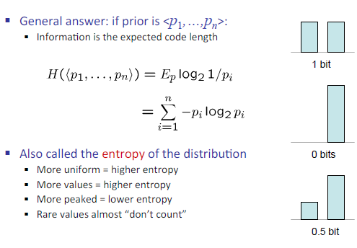
Entropy

Slide 10
Information gain
For each split, compare entropy before and after
Difference is the information gain
Problem: there’s more than one distribution after split!
Solution: use expected entropy, weighted by the number of examples
Low resulting entropy (which is good because it means no more randomness, we know the answer) => high information gain
To split, choose the variable that gives the higher information gain!

Slide 11
Attribute Selection – Information gain
D: set of examples, C_{i}: class i
Let p_{i} be the probability that an arbitrary tuple in D belongs to class C_{i}, estimated by |C_{i, D}|/|D|
Expected information (entropy) needed to classify a tuple in D:
Information needed (after using attribute A to split D into v partitions) to classify D:
Information gained by branching on attribute A

Slide 12
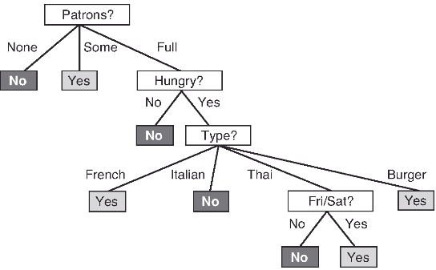
Result

Slide 13
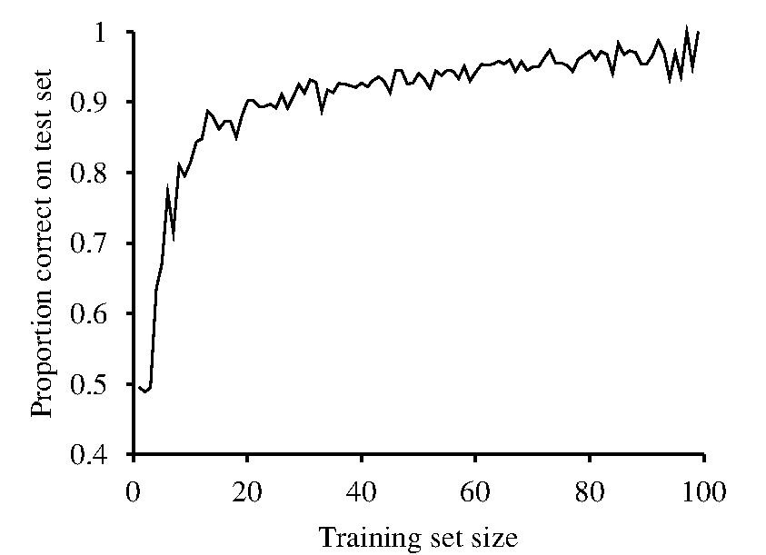
Effect of Training Set Size on Test Accuracy

Slide 14
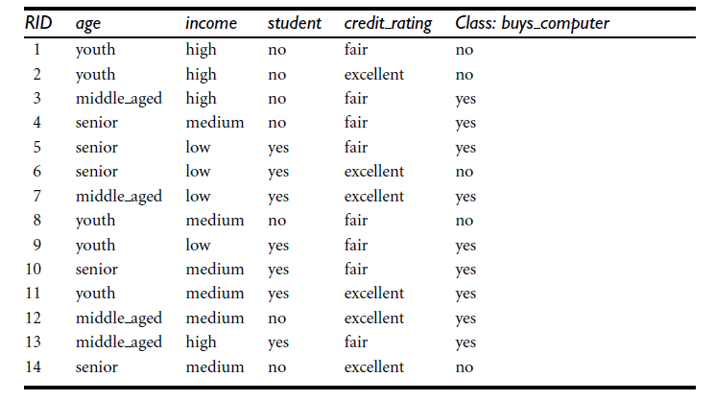
Exercise

Slide 15
Exercise – solution
Class P: buys_computer = “yes” 9
Class N: buys_computer = “no” 5
means “age <=30” has 5 out of 14 samples, with 2 yes and 3 no. Hence
Similarly,

